Slide 1
Priority Queue

Slide 2
Definition
A priority queue is a special type of queue in which each element is associated with a priority value. And, elements are served on the basis of their priority. That is, higher priority elements are served first.

Slide 3
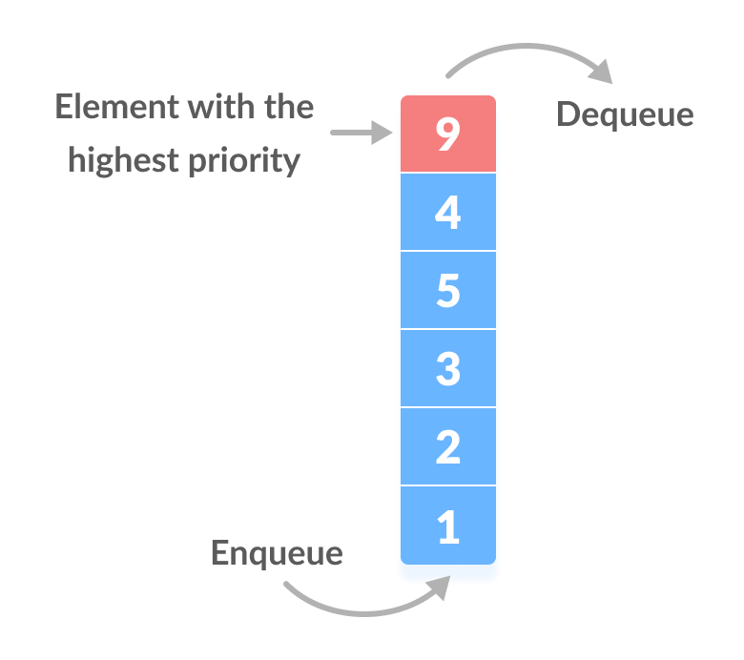
Assigning Priority Value
Generally, the value of the element itself is considered for assigning the priority. For example,
The element with the highest value is considered the highest priority element. However, in other cases, we can assume the element with the lowest value as the highest priority element.
We can also set priorities according to our needs.

Slide 4
Difference between Priority Queue and Normal Queue
In a queue, the first-in-first-out rule is implemented whereas, in a priority queue, the values are removed on the basis of priority. The element with the highest priority is removed first.

Slide 5
Implementation of Priority Queue
Priority queue can be implemented using an array, a linked list, a heap data structure, or a binary search tree. Among these data structures, heap data structure provides an efficient implementation of priority queues.

Slide 6
A comparative analysis of different implementations of priority queue is given below.
Operations | peek | insert | delete
Linked List | O(1) | O(n) | O(1)
Binary Heap | O(1) | O(log n) | O(log n)
Binary Search Tree | O(1) | O(log n) | O(log n)

Slide 7
Priority Queue Operations
Basic operations of a priority queue are
inserting,
removing,
and peeking elements.

Slide 8
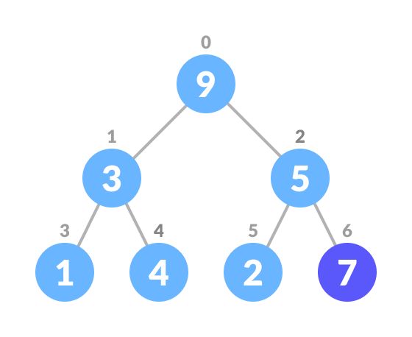
Inserting an Element into the Priority Queue
Inserting an element into a priority queue (max-heap) is done by the following steps.
Insert the new element at the end of the tree.

Slide 9
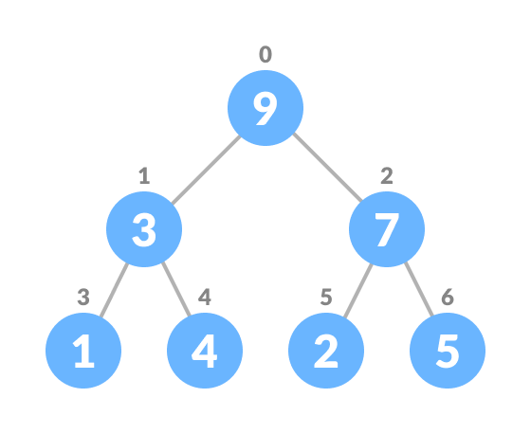
Heapify the tree.

Slide 10
Algorithm for insertion of an element into priority queue (max-heap)
If there is no node,
create a newNode.
else (a node is already present)
insert the newNode at the end (last node from left to right.)
heapify the array
For Min Heap, the above algorithm is modified so that parentNode is always smaller than

Slide 11
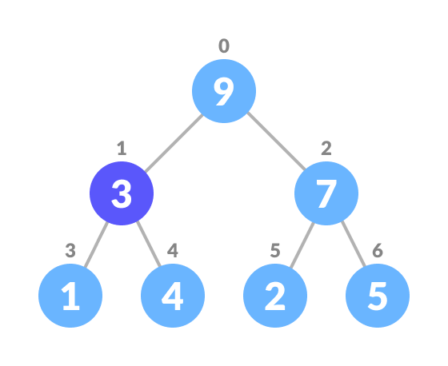
Deleting an Element from the Priority Queue
Deleting an element from a priority queue (max-heap) is done as follows:
Select the element to be deleted.

Slide 12
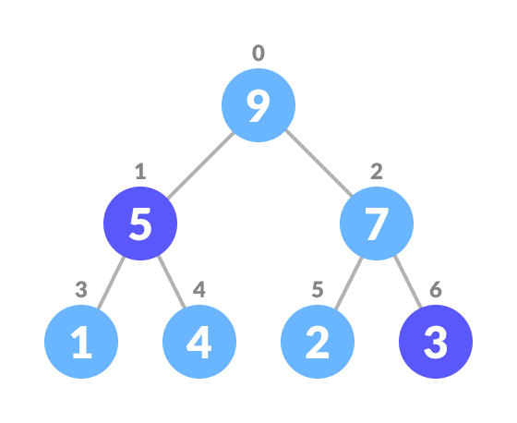
Swap it with the last element.

Slide 13
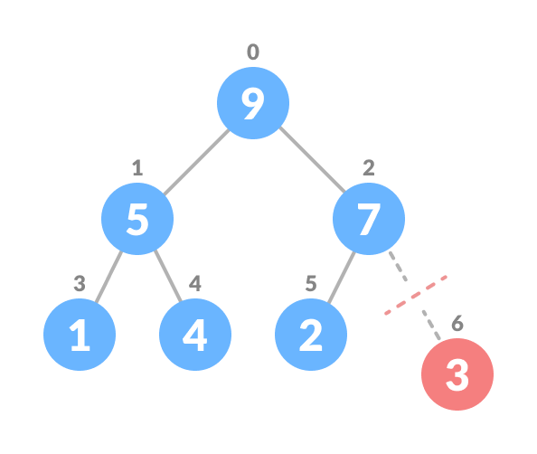
Remove the last element

Slide 14
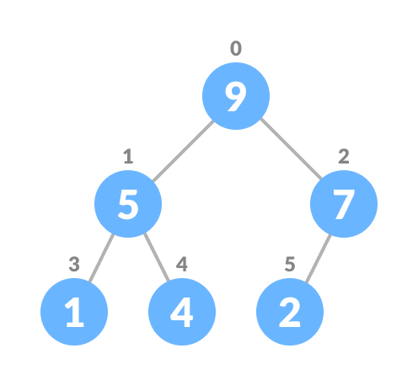
Heapify the tree.

Slide 15
Algorithm for deletion of an element in the priority queue (max-heap)
If nodeToBeDeleted is the leafNode
remove the node
Else swap nodeToBeDeleted with the lastLeafNode
remove noteToBeDeleted
heapify the array
For Min Heap, the above algorithm is modified so that the both childNodes are smaller than currentNode.

Slide 16
Peeking from the Priority Queue (Find max/min)
Peek operation returns the maximum element from Max Heap or minimum element from Min Heap without deleting the node.
For both Max heap and Min Heap
Return rootNode

Slide 17
Priority Queue Applications
Some of the applications of a priority queue are:
Dijkstra's algorithm
for implementing stack
for load balancing and interrupt handling in an operating system
for data compression in Huffman code

